Slide 1
Database Management Environment
The Client/Server Architecture

Slide 2
System Architecture
The architecture of a computer system is the high-level (most general) design on which the system is based
Architectural features include:
Components
Collaborations (how components interact)
Connectors (how components communicate)

Slide 3
System Architecture
Common architectural patterns include
Client-Server
Layered
Peer-to-peer
Pipes and Filters
etc.

Slide 4
Client/Server Systems
Networked computing model
Processes distributed between clients and servers
Client–Workstation (usually a PC) that requests and uses a service
Server–Computer (PC/mini/mainframe) that provides a service
For DBMS, server is a database server

Slide 5
Application Logic in C/S Systems
Presentation Logic
Input–keyboard/mouse
Output–monitor/printer
GUI Interface
Processing Logic
I/O processing
Business rules
Data manipulation
Procedures, functions,
programs
Storage Logic
Data storage/retrieval
DBMS activities

Slide 6
Centralized / Distributed
The client-server architecture can be thought of as a median between
Centralized processing: computation is performed on a central platform, which is accessed using “dumb” terminals
Distributed processing: computation is performed on platforms located with the user
Centralized
Client / Server
Distributed

Slide 7
Client-Server Architecture
Example: The Web is a client-server system
Web browsers act as clients, and make requests to web servers
Web servers respond to requests with requested information and/or computation
Client
Client
Client
Server
Server
Client
request
Client
Server

Slide 8
Tiered Web Architectures
Web applications are usually implemented with 2-tier, 3-tier, or multitier (N-tier) architectures
Each tier is a platform (client or server) with a unique responsibility

Slide 9
Client/Server Architectures
Client does extensive processing
File Server Architecture
Database Server Architecture
Client does little processing

Slide 10
File Server Architecture
FAT CLIENT
All processing is done at the PC that requested the data
Entire files are transferred from the server to the client for processing
Problems:
Huge amount of data transfer on the network
Each client must contain full DBMS
Heavy resource demand on clients
Client DBMSs must recognize shared locks, integrity checks, etc.

Slide 11
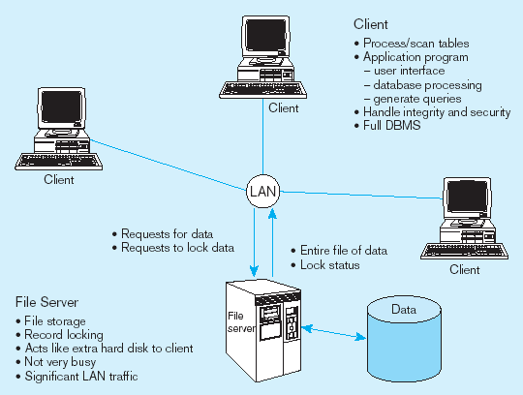
File Server Architecture
FAT CLIENT

Slide 12
Two-Tier Database Server Architectures
Client is responsible for
I/O processing logic
Some business rules logic
Server performs all data storage and access processing
➔ DBMS is only on server

Slide 13
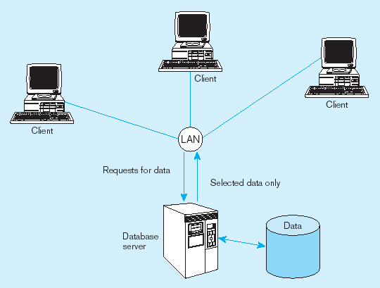
Two-tier database server architecture
Thinner clients
DBMS only on server

Slide 14
Advantages of database Two-Tier Approach
Clients do not have to be as powerful
Greatly reduces data traffic on the network
Improved data integrity since it is all processed centrally
Allows use of Stored procedures ➔ DBMS code that performs some business rules done on server

Slide 15
Advantages of Stored Procedures
Compiled SQL statements
Reduced network traffic
Improved security
Improved data integrity
Thinner clients

Slide 16
Three-Tier Architecture
Client
GUI interface
(I/O processing)
Browser
Application server
Web Server
Business rules
Database server
Data storage
DBMS
Thin Client
PC just for user interface and a little application processing. Limited or no data storage (sometimes no hard drive)

Slide 17
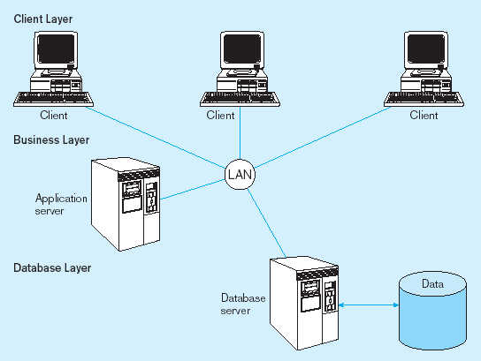
Three-tier architecture
Thinnest clients
Business rules on separate server
DBMS only on DB server

Slide 18
Advantages of Three-Tier Architectures
Scalability
Technological flexibility
Long-term cost reduction
Better match of systems to business needs
Improved customer service
Competitive advantage
Reduced risk

Slide 19
Multitier C-S Architecture
A multitier (N-tier) architecture is an expansion of the 3-tier architecture, in one of several different possible ways
Replication of the function of a tier
Specialization of function within a tier
Portal services, focusing on handling incoming web traffic

Slide 20
Application Partitioning
Placing portions of the application code in different locations (client vs. server) AFTER it is written
Advantages
Improved performance
Improved interoperability
Balanced workloads

Slide 21
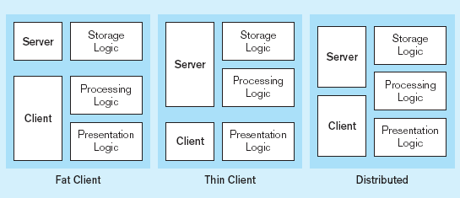
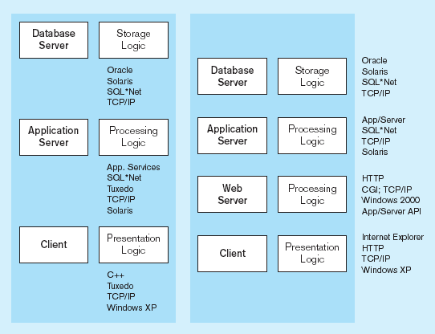
Common Logic Distributions
Two-tier client-server environment
Processing logic could be at client, server, or both
n-tier client-server environment
Processing logic will be at application server or Web server

Slide 22
Role of the Mainframe
Mission-critical legacy systems have tended to remain on mainframes
Distributed client/server systems tend to be used for smaller, workgroup systems
Difficulties in moving mission critical systems from mainframe to distributed
Determining which code belongs on server vs. client
Identifying potential conflicts with code from other applications
Ensuring sufficient resources exist for anticipated load
Rule of thumb
Mainframe for centralized data that does not need to be moved
Client for data requiring frequent user access, complex graphics, and user interface

Slide 23
Middleware
Software that allows an application to interoperate with other software
No need for programmer/user to understand internal processing
Accomplished via Application Program Interface (API)
The “glue” that holds client/server applications together

Slide 24
Types of Middleware
Remote Procedure Calls (RPC)
client makes calls to procedures running on remote computers
synchronous and asynchronous
Message-Oriented Middleware (MOM)
asynchronous calls between the client via message queues
Publish/Subscribe
push technology → server sends information to client when available
Object Request Broker (ORB)
object-oriented management of communications between clients and servers
SQL-oriented Data Access
middleware between applications and database servers

Slide 25
Database Middleware
ODBC–Open Database Connectivity
Most DB vendors support this
OLE-DB
Microsoft enhancement of ODBC
JDBC–Java Database Connectivity
Special Java classes that allow Java applications/applets to connect to databases

Slide 26
Client/Server Security
Network environment ➔ complex security issues
Security levels:
System-level password security
for allowing access to the system
Database-level password security
for determining access privileges to tables; read/update/insert/delete privileges
Secure client/server communication
via encryption

Slide 27
Keys to Successful Client-Server Implementation
Accurate business problem analysis
Detailed architecture analysis
Architecture analysis before choosing tools
Appropriate scalability
Appropriate placement of services
Network analysis
Awareness of hidden costs
Establish client/server security

Slide 28
Benefits of Moving to Client/Server Architecture
Staged delivery of functionality speeds deployment
GUI interfaces ease application use
Flexibility and scalability facilitates business process reengineering
Reduced network traffic due to increased processing at data source
Facilitation of Web-enabled applications

Slide 29
Using ODBC to Link External Databases Stored on a Database Server
Open Database Connectivity (ODBC)
API provides a common language for application programs to access and process SQL databases independent of the particular RDBMS that is accessed
Required parameters:
ODBC driver
Back-end server name
Database name
User id and password
Additional information:
Data source name (DSN)
Windows client computer name
Client application program’s executable name
Java Database Connectivity (JDBC) is similar to ODBC–built specifically for Java applications

Slide 30
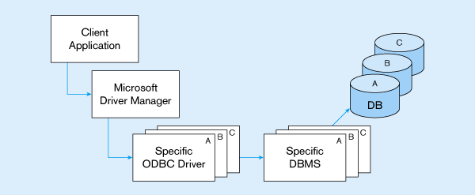
ODBC Architecture
Client does not need to know anything about the DBMS
Application Program Interface (API) provides common interface to all DBMSs
Each DBMS has its own ODBC-compliant driver

Slide 31
Characteristics Summary
large e-commerce, business, or organization
small e-commerce, regional business or organization
local business or organization
N-Tier
1000
3-Tier
users
100
2-Tier
10
capacity
scalability
redundancy
cost

Slide 32
Additional Reading
Modern Database Management 8th Edition by Jeffrey A. Hoffer, Mary B. Prescott, Fred R. McFadden – Chapter 9
Rai Foundation Notes – Lectures 19 and 19a

